Slide 1
Software Product Management Build, Measure, Learn & Pivot
Nandagopal Govindan

Slide 2
Contents
Build – Turn ideas into product
Measure – See how customers respond
Learn – What is valuable to customer
Pivot or persevere
Profile: Kate Arnold of Netflix (Inspired)
Case study: Slack journey (FirstRound)
Case study: “Design Within Reach” (4 Steps to Epiphany)

Slide 3
Introduction
Growth should be measured by the value it creates, not by the funding, amount of advertisement, etc. – Eric Ries of Lean Startup
Financial valuation of a company may increased for different reasons – venture funding, lack of competition, etc.
Real growth should be measured by the growth in value to customers
Example:
Are ecommerce customers finding it convenient shop?
Are they finding the products they want?
Are the products delivered on time?

Slide 4
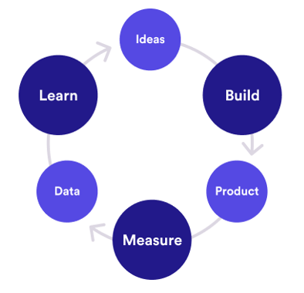
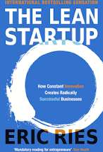
Build-Measure-Learn cycle
So we need to constantly learn what is valuable to customers
Customer interviews
Root cause analysis
Agile
Continuous integration
Minimize total time through the loop
# Visits, conversion, retention
How many use new feature?

Slide 5
Build
Build the product with minimum features, yet bringing compelling value
Example: Bounce
Minimum feature:
Book
Unlock
End ride
Pay
Features that can be left out for now:
Give feedback (assuming there is a call center)
View bike model and year of manufacturing
Frequent user analytics

Slide 6
Measure
Identify the right metric that indicates that customers are getting value from the product
Example:
# of rides per day in case of Bounce
# of messages / team in case of Slack
Eric Ries calls this as Innovation accounting (as opposed to accounting profit or review)

Slide 7
Measure …
A disciplined approach is needed to figure out if we are making progress through validated learning
Steps:
Establish a baseline using real data based on MVP
Example: 20 rides per day during MVP
Set a desired target: Reach a target of 100 rides in 3 months (based on certain assumptions)
Tune the engine, ie. make optimizations (such as UI improvements or adjust price) and measure again to see the difference
Pivot, ie. Make change to product feature or change target customer or some other change, if the desired outcomes are not met
Example: Provide helmet, Target delivery boys instead of Metro riders (based on a new hypothesis)

Slide 8
Growkit case (Lean Startup)
Farbood Nivi was a popular & effective teacher
He discovered that a combination of following approaches is needed effective teaching:
Teacher led lecture
Individual home work
Group study (Peer-driven learning)

Slide 9
Growkit case …
Step1 :
Used WebEx to teach (Teacher-led learning)
Measured # of customers, # of questions answered, etc.
Added new ways for students to interact with each other. Conducted split (A/B) test. But this did not improve customer behavior.
Allowed lazy registration feature. Conducted split (A/B) test. But this also did not have any impact (Optimization)

Slide 10
Growkit case …
Step2:
They had missed implementing one important need: Choice of solo learning and group learning
Introduced this feature and did A/B testing
This led to significant increase in customer behavior

Slide 11
Experience sharing
Did you make any changes to the product to enhance value?

Slide 12
Importance of A/B testing
Do not add a feature unless A/B testing reveals value to customer

Slide 13
Metrics should be actionable, accessible, auditable
Actionable:
We should be able to take some action based on the metric. Example:
Consider 2 metrics in a gaming software
% of visitors who signed up for a gaming software
# of chat messages exchanged between players
Signup % is actionable. If it is not improving, we can try to investigate and make changes
# of chat messages exchanged: This metric is not a very actionable. We are not sure what action to take

Slide 14
Metrics should be actionable, accessible, auditable
Accessible:
The metrics should be easy to understand. Eg. IMUV – a multi-player game
How many downloaded
How many used trial version
How many upgraded to paid version

Slide 15
Metrics should be actionable, accessible, auditable
Auditable (verifiable):
Sometimes when A/B test reveals that a feature is not impactful, some people who proposed the feature do not want to give up and start questioning the veracity (dependability) of the data.
They say that the data collected may be inaccurate
In such situations it should be possible to know which users preferred the new feature and who did not.
Then we can do a random check by calling those people and validating the data.
So we need to record customer names and contact details of customers who used the feature and who did not

Slide 16
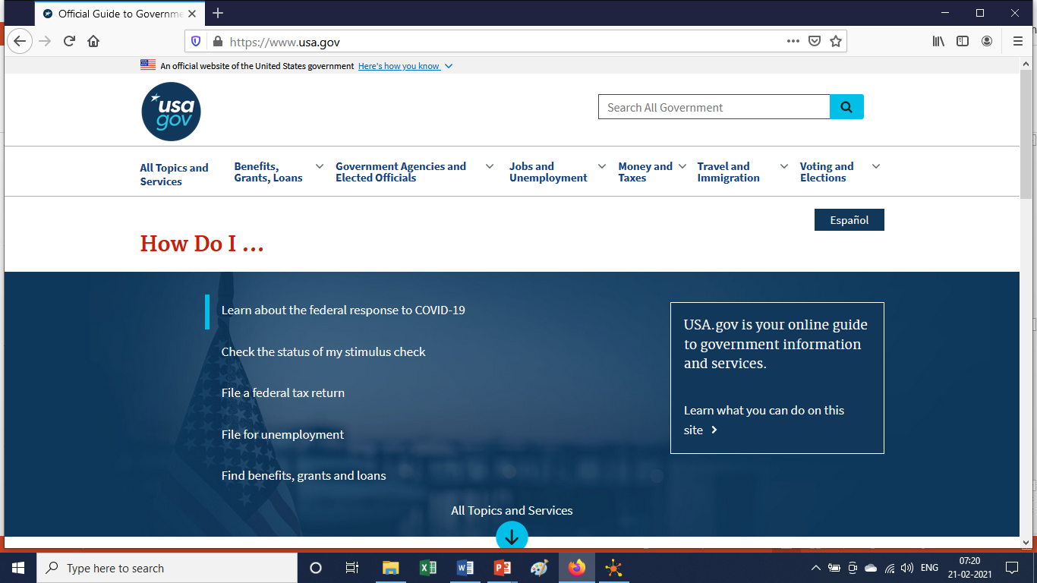
Votizen case
David Binetti started Votizen (he was earlier manager of USA.Gov)
He wanted to tackle the problem of civic participation in the political process

Slide 17
Votizen: MVP
Hypothesis: People interested in civic matters would like to engage with other similar people
Created a social networking platform for verified voters to get together, share ideas, recruit friends
Only 5% signed up
Tried to make it easier to use. Signup increased by 17% (used A/B testing)
He did more optimization. But sign up remained at 17%. Which means the citizens were not getting much value.
He had heard recurring feedback that citizens wanted to get more involved
So he decided to change the strategy

Slide 18
Votizen: Pivot (Zoom In)
New hypothesis: Passionate activists would be willing to pay for facilitating contacts with elected representatives
Converted into social lobbying platform “@2gov” that enabled citizens to reach elected representatives
Citizens would use existing social media platform such as Twitter to send message to @2gov and this message would be passed on to the elected representatives on paper since the politicians were less tech savvy
Signup increased to 42% but people willing to pay was just 1%. Revenues remained low

Slide 19
Votizen: Pivot (Customer segment)
Hypothesis: Large org, non-profit org. and fund raisers who are interested in political campaigning would be interested to contact the elected representatives
David contacted them and many signed LoI (Letter of Interest).
After developing the product, org did not show interest in paying for it ,in spite of multiple follow up

Slide 20
Votizen: Pivot (Platform)
Getting inspiration from Google AdWords platform, he converted the product into a self-serve platform for citizens to send message to elected representatives at 20 cents per message.
Revenue increased significantly from 1% to 11%

Slide 21
Votizen: Quick iterations
1st MVP took 8 months
2nd 4
3rd 3
4th 1

Slide 22
Votizen: Lesson
We should not get stuck on our ideas and replace the hypothesis based on new learning about the customer.
The company could have got funding and survived but the value would not increase.
That is why we must measure the impact of each change and decide if we should pivot or persevere with what we have.

Slide 23
Votizen: Achievements
The company got a funding of $1.5 million from Facebook’s initial investor Peter Thiel.
Startup Visa campaign used Votizen which resulted in the Startup Visa Act (S.565).
This was the first legislation introduced via social lobbying.

Slide 24
Types of pivots
Zoom in: One feature blown up
Zoom out: Many features combined into one as there is not much interest in so many features. Example
Customer segment: Individual or Organization
Customer need (through customer intimacy)
Eg. Pot Belly sandwich which started as an antique store (1977) gave sandwiches to customers to make them stay. But they found that customers like sandwiches more than antiques
Platform pivot: A specific use application to a platform (like AirBnB)
Channel pivot. Instead of selling a product via consulting firms, a company may decide to sell directly (SaaS).
Business architect pivot: Low volume high margin to High volume low margin. Example Clinic shampoo Sachet
Technology pivot: Same solution using different technology (eg mobile) this is used by large corp to improve their service.
Engine of growth pivot: Viral, sticky or paid growth

Slide 25
Experience sharing…
What pivots did you use in your product to enhance value?

Slide 26

Pivot case study: Netflix
What was the solution used by Kate to address the problem of customers not bothering to return the DVD?
How did they address the issue of needing to stock popular & expensive DVDs which were in high demand?
What can we learn about the role of Product manager from this story of Kate?

Slide 27

End-to-end Case study
What lessons can we learn from Slack in the area of:
MVP
Pivot
User vs Buyer
Identifying product features
Marketing & growing the market
Customer support
Strategy
Metrics & Analytics

Slide 28

End-to-end case study
What was the pain point Rob was trying to address?
What was the MVP he used?
Why did Rob refuse to start e-com business?

Slide 29
Appendix

